Slide 1
CAPSTONE PROJECT
Battle of Neighbourhoods

Slide 2
1. Introduction
The City of New York, is the highly populous city in the USA. It has business opportunities and offer friendly environment. As it is highly developed city, it is subjected to high business costs. There is need to conduct a proper analysis in order to understand Business Viability for anyone who needs to open a restaurant. This project will explore locational factors, recommend a proper location and provide the benefits of such a location

Slide 3
Problem Description:
There are numerous location in New York City and there are various social grouping, now the challenge is to know the best location to establish a restaurant. This location should take various issues into consideration while at the same time be of both economic and business sense

Slide 4
The questions that need to be answered
What is the best location for Japanese cuisine in New York City?
In which Neighbourhood an investor should open a Japanese restaurant and become successful?

Slide 5
Methodology
Data will be collected from https://cocl.us/new_york_dataset and cleaned and processed into a data frame. Foursquare will be used to locate all venues and then filtered by Japanese restaurants. Ratings, tips, and likes by users will be counted and added to the data frame. Data will be sorted based on rankings. Additionally, the data be will be visually assessed using graphing from Python libraries.

Slide 6
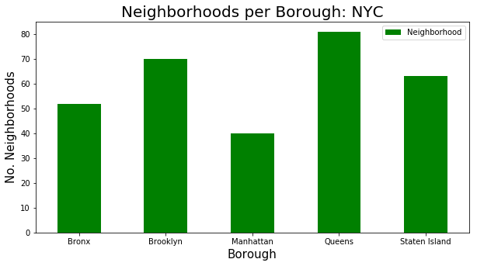
Analysis
An analysis has been conducted to understand the Neighbourhoods in the New York City, below is a diagram that presents Neighbourhood 5 boroughs within New York City.
Figure 1: Neighbourhoods within New York City

Slide 7
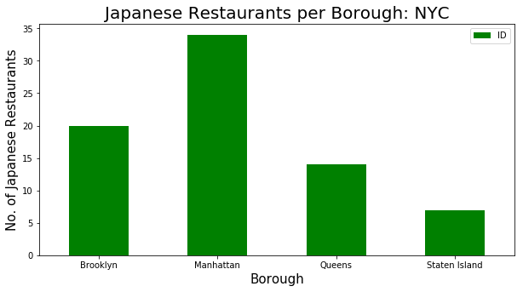
The graph above shows that Queens has the highest number of neighbourhoods followed by Brooklyn. And Manhattan has least number of neighbourhoods.
The analysis went on to explore restaurants with each borough, the figure 2 below shows per borough.
Figure 2: Japanese restaurants per Borough

Slide 8
Figure 2 above indicates that Manhattan has the highest number of Japanese restaurants
This analysis would help to understand competition when choosing a location to open a Japanese restaurant
Narrowing down the analysis might be of great help, below, an analysis of restaurants per neighbourhood was also performed.

Slide 9
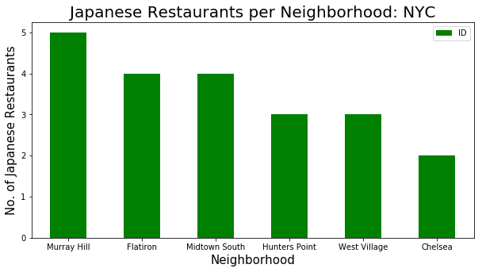
Figure 3: Japanese restaurants per Neighbourhood

Slide 10
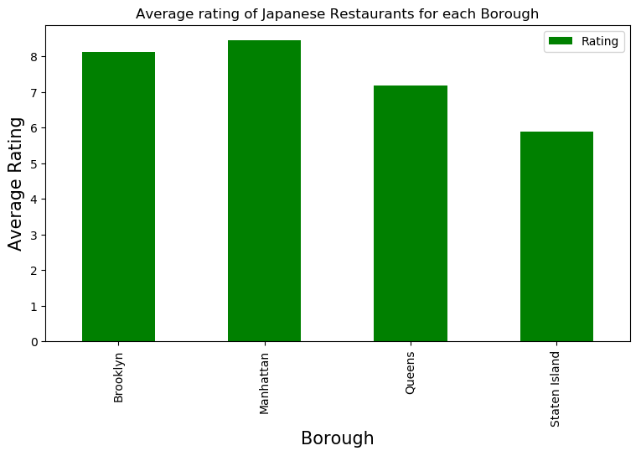
Figure 3 above show Japanese restaurants per neighbourhood. Murray Hill has the largest and Chelsea has the lowest.
Figure 4: Japanese restaurants ratings
Figure 4 below shows Japanese restaurants rating per Borough.

Slide 11
Conclusion
Manhattan and Brooklyn have the best rated Japanese restaurants on average. Staten Island and The Bronx have the least amount of Japanese restaurants per borough and Murray Hill in Manhattan has the highest number of Japanese Restaurants in all of NY. Although Manhattan has the least number of neighbourhoods in all five boroughs, it has the most Japanese restaurants. Having considered this, Manhattan and Brooklyn are the best locations for Japanese cuisine in NYC. This analysis would recommend the opening of a Japanese restaurant in Brooklyn since Brooklyn has a high number of neighbourhoods with average ratings.

